Slide 1
Text Generation: Story Ending Prediction
Could T5 model understand the causal relationship and generate reasonable story endings?
Ming Chen Fengyao Luo
mingchen@ischool.berkeley.edu fengyaoluo@berkeley.edu
Notes:
Our presentation topic is …

Slide 2
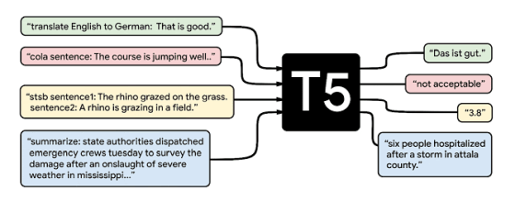
Introduction
Translation
Grammar Check
Similarity Score
Summarization
Rick grew up in a troubled household. He never found good support in the family, and turned to gangs. It wasn't long before Rick got shot in a robbery. The incident caused him to turn a new leaf.
He is happy now.
Story Ending Prediction
Notes:
We have learned from class, T5 model can be applied to many different task. We were thinking about if T5 model can have one more extended functionality - story ending prediction. The input is some story sentences, and the output will be the story ending.

Slide 3
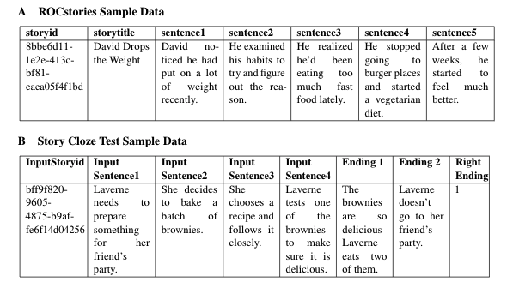
Dataset
Notes:
Here are the datasets we used in our project.
ROCStories Corpora, story id , title, 5 sentences
Story Cloze Test is a new commonsense reasoning framework for evaluating story understanding, and story generation. It has story id 4 sentences, ending 1 & 2 and the label to show the correct ending

Slide 4
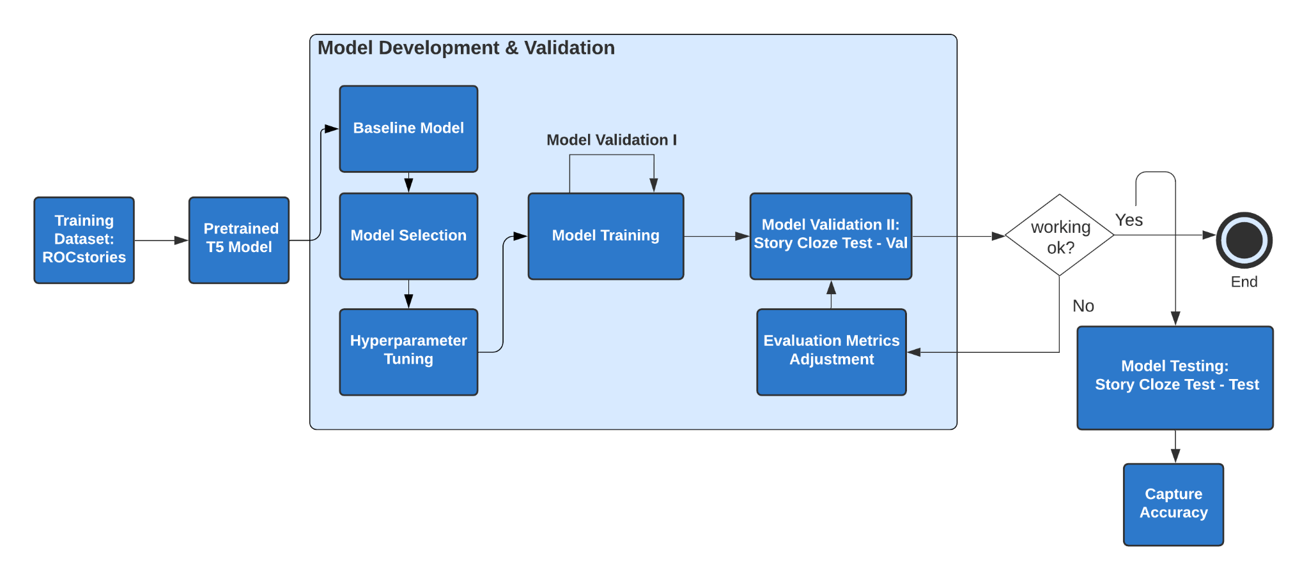
Pipeline
Notes:
In our research, we took an unsupervised approach and used the T5- base model. We did limited hyper parameter tuning, eg, we set smaller batch size, changed greedy search to beam search, generated 5 outputs for each story etc..
Since our training data does not have ending 1 and ending 2 options, our output for the sentence 5 prediction is in free text format. Therefore, we designed two layers of validation .
In the first layer, the validation data was 20% of the random sampled training data and we used Binary Cross Entropy Loss to evaluate the performance of the text generation.
In the second layer, the validation data was from the Story Cloze Test and we used the Simi-Senti scoreas our evaluation metrics

Slide 5
Evaluation Metrics Adjustment
T5 Sentence Similarity.
“stsb sentence 1: ..., sentence 2: ...’.
The embedding is from the Pre-trained T5 base model
Universal Sentence Encoder
The embedding is from Universal Sentence Encoder large model
VADER sentiment analysis(Valence Aware Dictionary for Sentiment Reasoning)
Specifically attuned to the sentiments expressed in social media.
Flair - NLP sentiment analysis
Pretrained on IMDb movies reviews and based on a character-level LSTM neural network
Outputs “positive” or “negative” to label the sentence
Simi_Senti score = Sentiment consistency indicator * 1 + similarity score
Notes:
After obtaining the output sentences from the fine-tuned T5 model, we used two different ways to measure sentence similarity: T5-sentence similarity and Universal Sentense Encoder
In the Story Cloze Test, the right ending usually goes with the flow of the previous 4 sentences, which means that the right ending shares the similar sentiment with the input 4 sentences. Flair sentiment analysis has reached the state of arts in various datasets, which also provided us the best result for our SCT dataset.
Finally We defined our Simi-Senti SCORE calculation as sentiment consistency indicator * 1 + similarity score

Slide 6
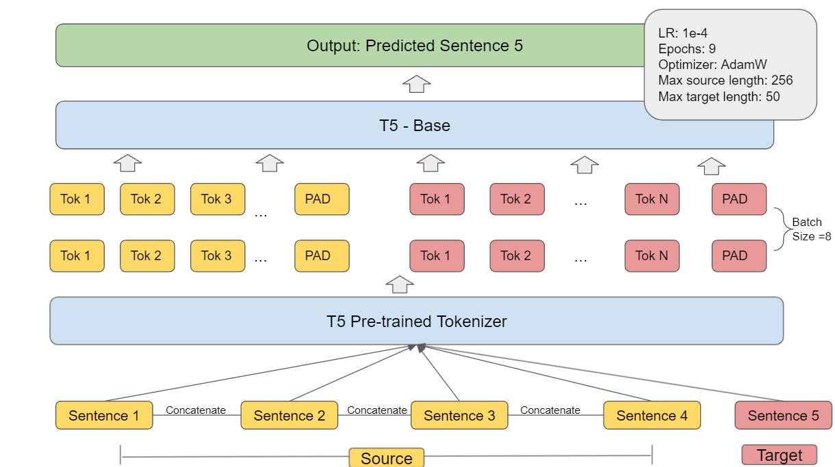
Baseline Model
Notes:
In our baseline model, we formatted the model input as a small paragraph, which concatenated the first 4 sentences and the corresponding output as the 5th sentence. We then further breakdown sentences into tokens and then we pad all the sentences to the same length, which is 256. We passed the tokens into the base model, through back propagation, our loss kept decreasing. In the end, we output the prediction of sentence 5 to compare with the target sentence.

Slide 7
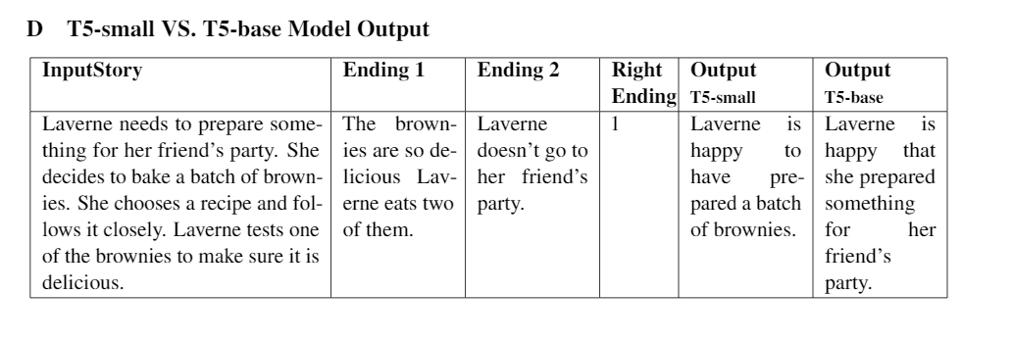
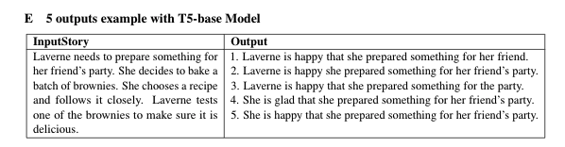
Experiments
Notes:
we experimented with both T5-small and T5-base model. The T5-small model has 60 million parameters and The T5-base model has 220 million parameters. Here is he the prediction result examples from T5-base and T5-small models.
In our baseline model, we only generated one ending for each story. In fact, one story could have many possible endings. In order to add some variance to the output, we tried to generate 5 outputs for each story by tuning Number of Return Sequence and Beam Size。

Slide 8
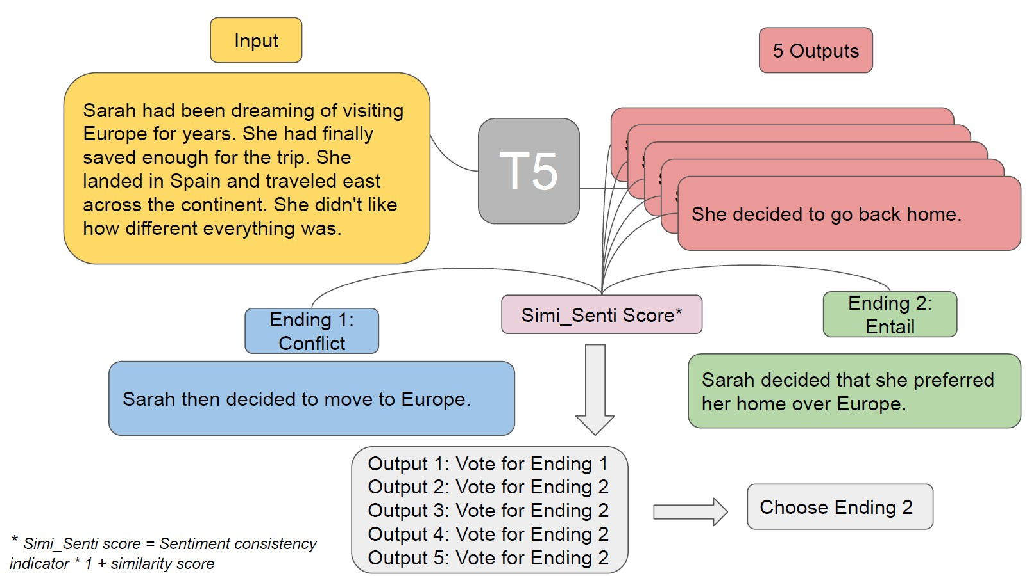
Experiments
Notes:
After using the best model to make the prediction on the Story Cloze dataset, we validated the model performance by using Simi-Senti score to get the accuracy score.
We generated 5 outputs for each story, so we got 5 Semi-Senti scores for each ending. Each pair of the Simi-Senti scores could contribute one vote. Then we picked the final label which have the highest vote

Slide 9
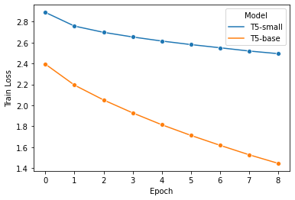
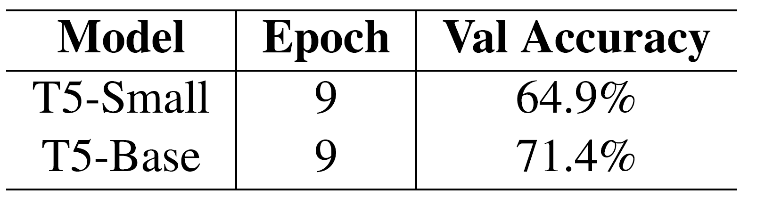
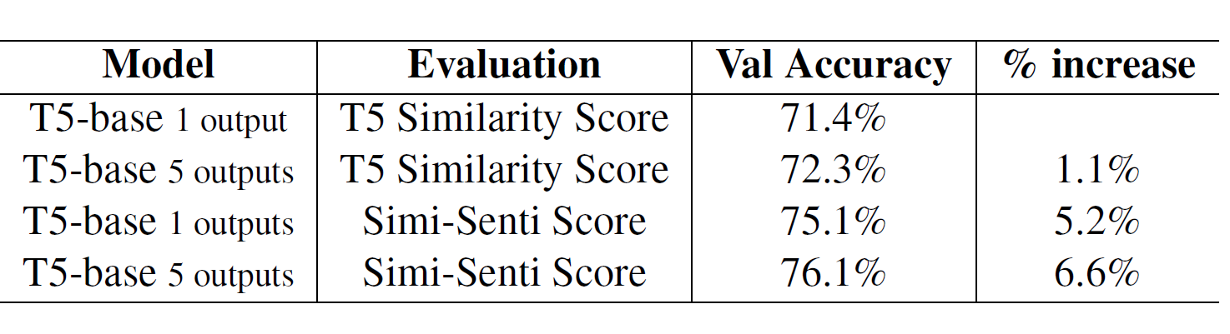
Experiment Result
With 50K + training examples, T5 base works better than T5 small.
Model output enhancement only improved performance by 1.1%.
Add Simi-Senti scores improved performance by 5.2%.
Notes:
Thank you Ming. Here I will present the experiment results. We found out that T5 base worked better than T5 small in our case, because we have over 50 thousands training examples. We did not train T5 large model due the constraints of our equipments, but we do encourage other researchers who are interested in this topic to continue.
Therefore, we experimented rest of our enhancement on the T5 base model and we found out that after adding the 5 outputs, we improved the accuracy by 1.1% and reached 72% accuracy on the validation set.
After adding the Simi-Senti scores, the baseline has been improved by 5.2% and reached 75% accuracy.
After adding the 5 outputs, and simi-senti scores, we reached an accuracy of 76%, which has increased 6.6% compared to baseline.

Slide 10
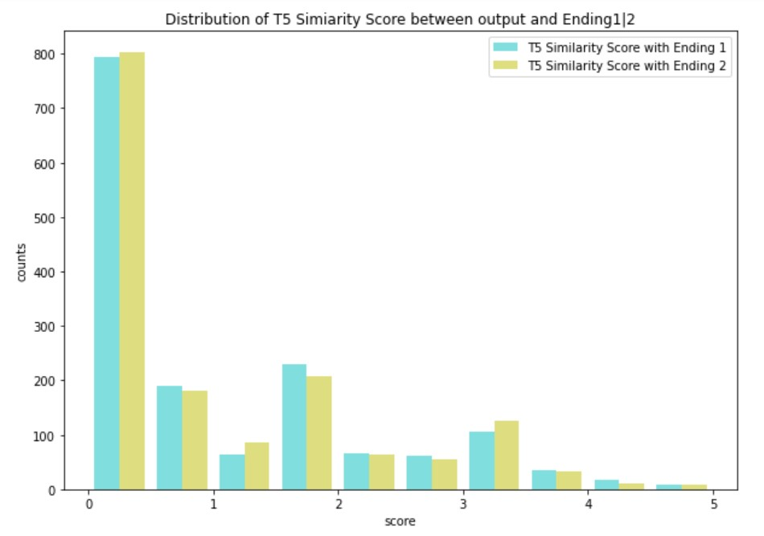
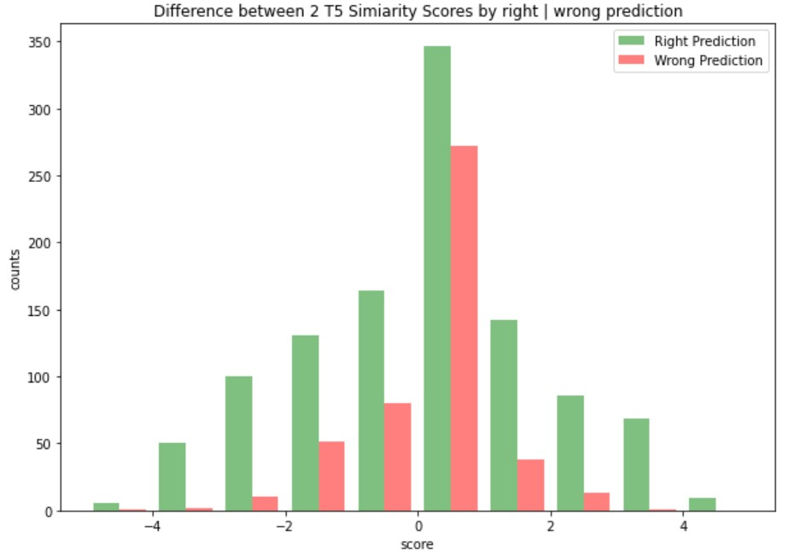
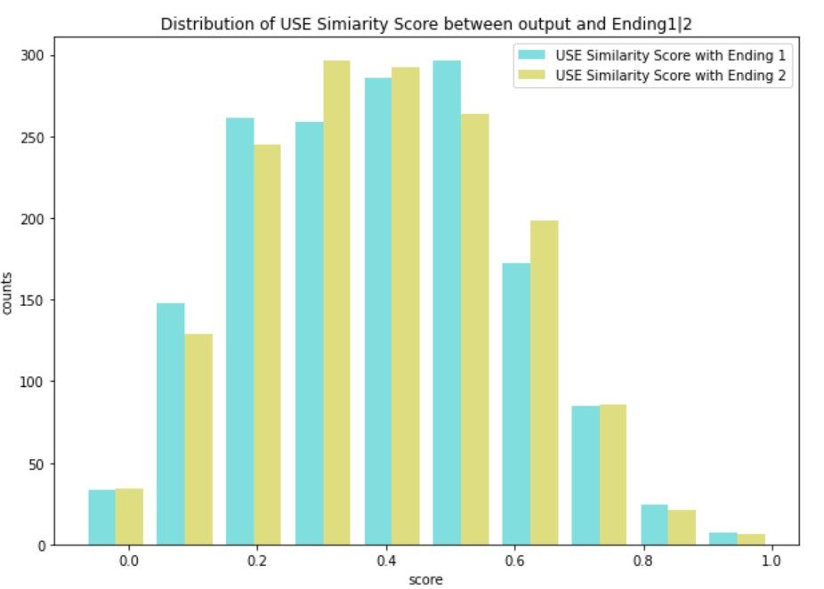
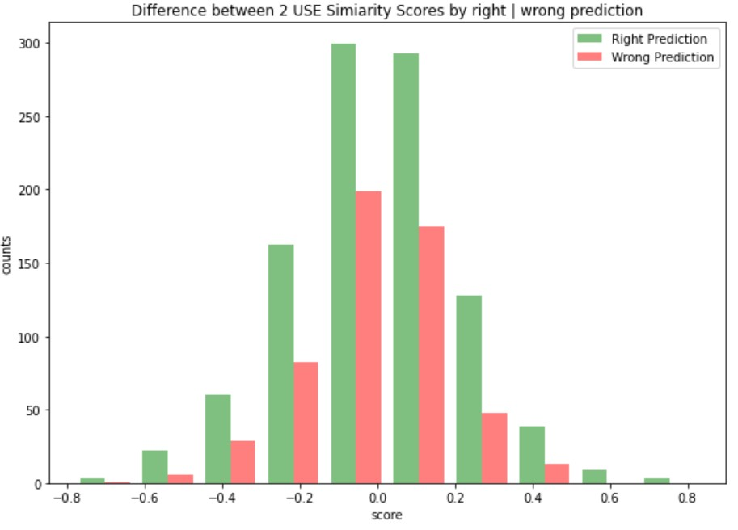
Error Analysis
For Baseline:
T5 similarity scores outputs lots of zeros.
Similarity scores between output and ending 1 or ending 2 are very similar.
After improvement:
5 outputs are very similar as each other
Simi-senti significantly improve the accuracy of the cases which have similar similarity scores.
Notes:
For the error analysis, we compared the difference between 2 similarity scores. The top left graph shows the distribution of T5 similarity scores, which indicates that most of the time, the output was not similar to any of the ending. It was one of the biggest challenges of this task, as story ending predictions can be various. The top right graph shows that the difference between similarity scores and we observed that the difference between two similarity scores are very close.
The bottom left graph shows the distribution of Universal sentence encoder similarity scores.
The USE scores are displayed as slightly right skewed distributions. Most of the similarity scores are gathered between 0.2 to 0.6, which indicates that most of the cases, outputs are somewhat similar to two endings in the perspectives of the inner product of two sentence vectors. However, the same issue with T5 similarity score, we observed that the difference between two similarity scores are very close,
Overall. the key struggle here is that although the model can output very reasonable next sentence prediction but the story endings can go all different directions, thus we need to improve our evaluation process.
After applying the Simi_senti score, we significantly reduced the number of errors from 449 to 375. Among these errors, adding sentiment scores helped to capture the correct emotions that went with the flow of the stories. For the next steps, it could be helpful to use the Flair model to study the sentiment of input sentences, or the fourth input sentence, add into the weighted similarity score, which probably is helpful to find the correct ending.

Slide 11
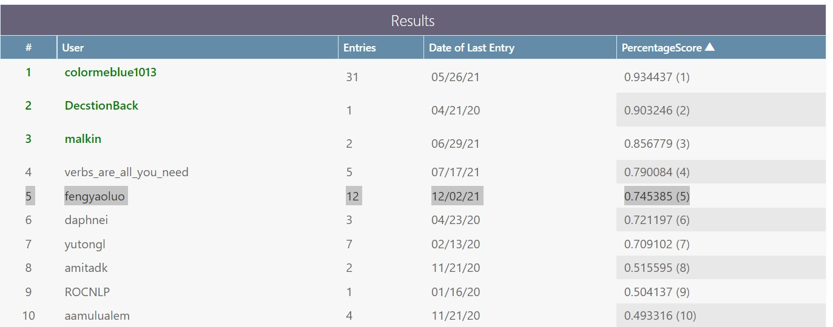



Conclusion
Test Accuracy: 74.5%
Leaderboard position: 5th
fengyao & ming
Future work:
Separating the input 4 sentences into “beginning” & “middle”
What we have learned:
Prefix: Fine Tuning T5
Evaluation process
Notes:
After we fine tuned our model, and applied the enhancement for evaluation process, we are happy to reach a test accuracy of 74.5% on the leaderboard of Story Cloze Test Winter 2018, which is the 5th position of the leaderboard.
In terms of future work for this study, it can be done through separating the input 4 sentences into “beginning”, “middle”, and then add attentions between two parts. and using both of them to predict the ending.
Lastly, I just would like to mention what we have learned. One thing that surprised us is that adding prefix does not help with the model. As we all know using T5 pertain model, we need to specify the task, for example translate German to English etc. In our case, we have fine tune the T5 model to a specific task, and with this task, we do not need to have the prefix. The original T5 is tuned on multiple tasks on a large number of corpus, which needs the predix to specify.
also, we learned that Not only model matters, but also the evaluation process. We are happy to experiment the end to end process of natural language processing

Slide 12




Q&A
Ming Chen
mingchen@ischool.berkeley.edu
https://github.com/xiaowanzio8
Fengyao Luo
fengyaoluo@berkeley.edu
https://github.com/fengyaoluo
Notes:
That is all for our presentation, we wanna give our huge thanks to professor Joahchim for coaching us during office hour. It was a pleasure to study with all of you here for this semester. Now we are open to any questions, comments or feedback.

Slide 13
Reference
Mostafazadeh, Chambers, N., He, X., Parikh, D., Batra, D., Vanderwende, L., Kohli, P., & Allen, J. (2016). A Corpus and Evaluation Framework for Deeper Understanding of Commonsense Stories.
Elazar, Mahabal, A., Ramachandran, D., Bedrax-Weiss, T., & Roth, D. (2019). How Large Are Lions? Inducing Distributions over Quantitative Attributes.
Ippolito, Grangier, D., Eck, D., & Callison-Burch, C. (2020). Toward Better Storylines with Sentence-Level Language Models.
Li, Ding, X., & Liu, T. (2019). Story Ending Prediction by Transferable BERT.
Zhou, Geng, X., Shen, T., Long, G., & Jiang, D. (2021) EventBERT: A Pre-Trained Model for Event Correlation Reasoning.
Radford, A., & Narasimhan, K. (2018). Improving Language Understanding by Generative Pre-Training.
Roemmele, Kobayashi, et al., (2019) An RNN-based Binary Classifier for the Story Cloze Test
Mostafazadeh et al., (2016) A corpus and cloze evaluation for deeper understanding of commonsense stories. NAACL, pages 740–750, 2016.
Liu, Zhang, H., Jiang, S., & Yu, D. (2019). DEMN: Distilled-Exposition Enhanced Matching Network for Story Comprehension.
Cer, Yang, Y., Kong, S., Hua, N., Limtiaco, N., John, R. S., Constant, N., Guajardo-Cespedes, M., Yuan, S., Tar, C., Sung, Y.-H., Strope, B., & Kurzweil, R. (2018). Universal Sentence Encoder.

Slide 14
Thank you!

Slide 15
Template

Slide 16
Introduction

Slide 17
Template

